Slide 1
Capstone Project The Battle of Neighborhoods
Selecting the best location to open a CHINESE RESTAURANT IN PARIS

Slide 2
Introduction/Business Problem
The City of Paris is famous for its excellent cuisine. It's food culture includes an array of international cuisines influenced by the city's immigrant history.
Chinese restaurants have become so popular in France now it seems that there is one on every corner, not only in major cities but also in smaller cities. Starting a Chinese restaurant can be a great business opportunity, but you need to distinguish yourself from others to enjoy long-term success.

Slide 3
Business Problem
My client wants to open his business somewhere around Louvre, Bourse, Temple, Hôtel-de-Ville, Panthéon, Luxembourg and Palais-Bourbon area, so I focus on those boroughs during my analysis.
We define potential neighborhood based on the number of Chinese restaurants which are operating right in each neighborhood. Paris has full potential but also is a very challenging district to open a business because of high competition.
New Chinese restaurants should be open in an area that inadequate neighborhood in this way the restaurant can attract more customers. Therefore, this analysis necessary to ensure that we have enough customers and that we are not so close to other such places.

Slide 4

Data Selection
To identify the characteristics of our competitors' venues in Paris, we would first need to find out the number of Chinese restaurants in Manhattan currently and their location.
We then used Foursquare API to find their geographic coordinates based on their postal code addresses.
In Paris, 1128 Chinese restaurants are currently operating.

Slide 5
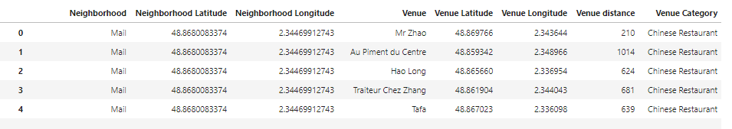
Data Selection
Next, we also used FoursquareAPI to find their geographic coordinates of the 5 locations shortlisted for our Chinese restaurants:
Table 2: Data frame containing geographic coordinates of our 5 shortlisted locations

Slide 6
Methodology
Addresses are converted into their equivalent latitude and longitude values.
Foursquare API is used to explore neighborhoods in Paris, France.
After that, explore function to get Chinese restaurant categories in each neighborhood.

Slide 7
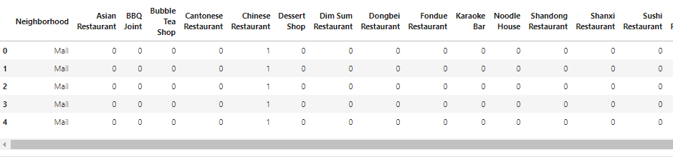
Methodology

Slide 8
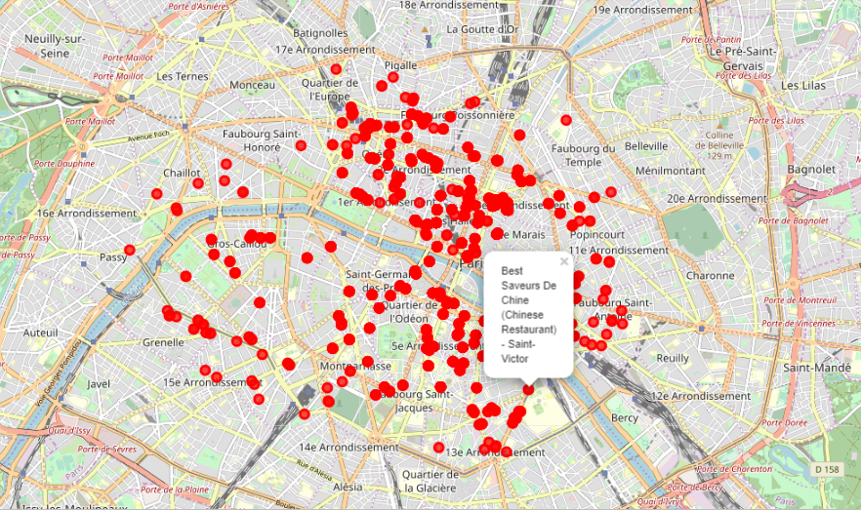
Methodology
Chinese restaurants in Paris near Louvre, Bourse, Temple, Hôtel-de-Ville, Panthéon, Luxembourg and Palais-Bourbon,

Slide 9
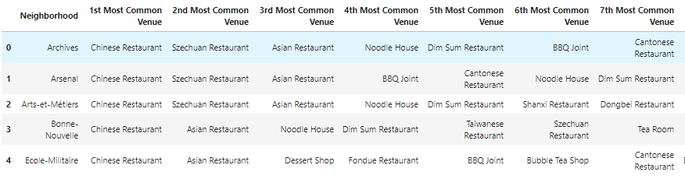
Methodology
Then using this feature to group the neighborhoods into clusters K-means clustering algorithm will be use to complete this task. And also, the Folium library to visualize the neighborhoods in Paris and its emerging clusters.

Slide 10
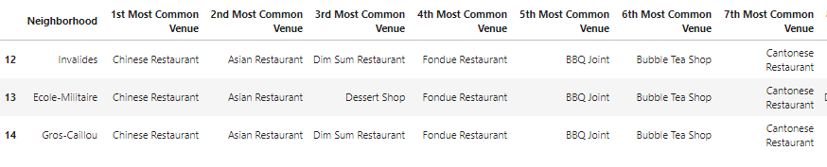
Results
Using K-mean to clustering data area with less number of sushi bars
Cluster 0

Slide 11
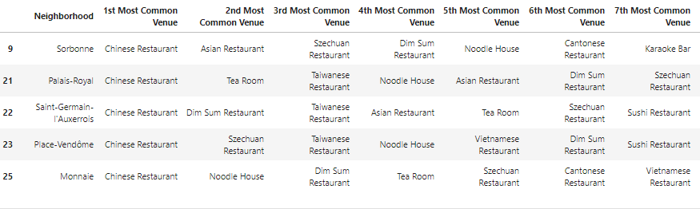
Result
Cluster 1

Slide 12
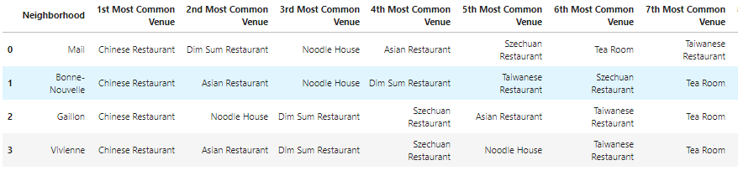
Result
Cluster 2

Slide 13
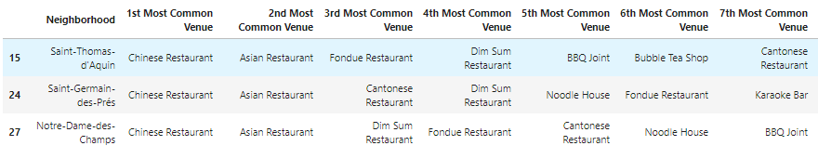
Result
Cluster 3

Slide 14
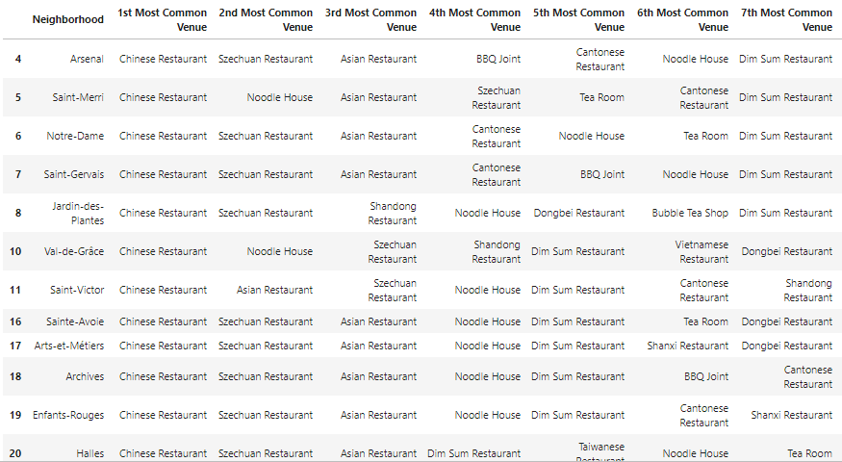
Result
Cluster 4

Slide 15
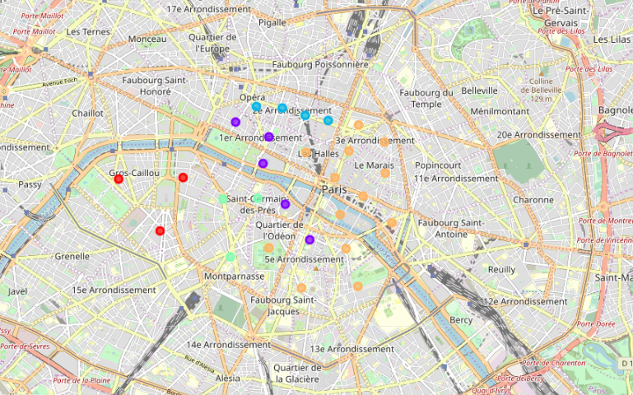
Result

Slide 16
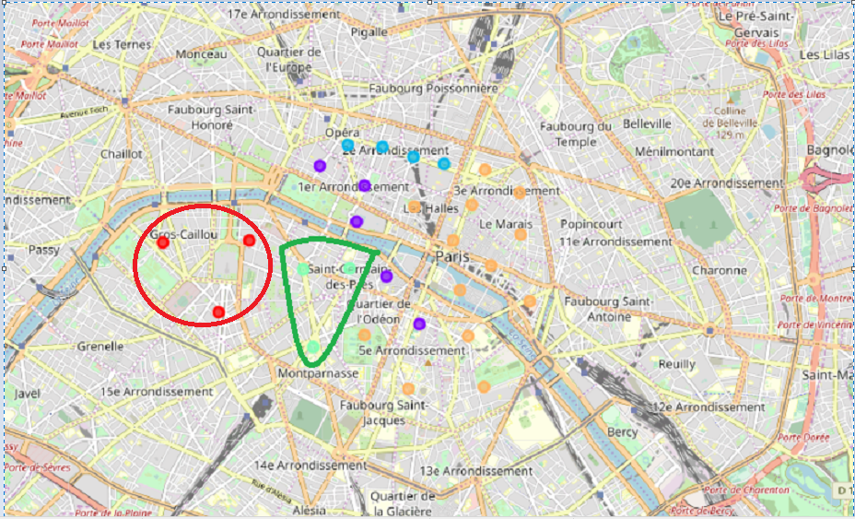
Result
Based on dataframe analysis above
Cluster 0 (Invalides, Ecole-Militaire, Gros-Caillou) and
Cluster 3 (Saint-Thomas d'Acquin, Saint-Germain-des-Près, Notre-Dame-Des-Champs)
areas are the best places to open a new Chinese restaurant business.

Slide 17
Discussion
This analysis is performed on limited data and on reduced perimeter. We have focused our research on boroughs only. This may be right or not, but if good amount of data were available there is scope to come up with better results.
There is high competition around Notre-Dame, Jardins-des-Plantes and Val-de-Grace so it is very risky to open business in these areas.
Sorbonne has also potential where it’s closes to University and high schools.
We can more detailed analysis by adding some factors such as transportation, demographics of inhabitants.

Slide 18

Conclusion
Although the goals of this project were met there is a lot to do to improve it.
In this study, I analyzed the relationship between business development and some useful machine learning technics such as clustering to group a set of Chinese
With this analysis, my client can choose the place where open his Chinese restaurant.

